Slide 1
Covid-19 and Post-Covid-19 impact on the stock market sectors

Slide 2

HELLO!
I am Anadi Mishra
I am here because my coffee ran out.

Slide 3

HELLO!
I am Gokce Gokmen
I am CIT student

Slide 4
Table of Contents
Project Proposal
Covid Dataset
Data Processing
Data Analysis
Sentiment Analysis
Dataset Generation
Stock Analysis + Model
Data Collection
Data Processing
Data Analysis
LSTM Model Development
Improvement
Things we Learned
Dasvidaniya

Slide 5

Project Proposal Revisited
Goal : To predict stock market segment trends based off of current Covid-19 sentiment.
Problem : More than regular unpredictable Price action during Covid-19 and post-recovery period in the Stock Market.
Different Stock Data

Slide 6
Covid-19 Dataset +
Sentiment Analysis
1

Slide 7


Coronavirus Dataset Collection
FROM March 20,2020 01:37 AM
TO July 12,2021 10:10 AM

Slide 8


TWEET ID HYDRATION
According to Twitter Developer Policy, Only the tweet IDs, user IDs and/or message IDs can be shared publicly. The process of retrieving a tweet’s complete information using its ID is known as the hydration of a tweet ID.

Slide 9
Hydrating tweet IDs
Using twarc python library
from twarc import Twarc
consumer_key=""
consumer_secret=""
access_token=""
access_token_secret=""
for tweet in t.hydrate(open('tweet_ids.csv'))
Using Hydrator Desktop Application
“Link Twitter Account.”
“Add Dataset”
“start hydrating the tweet IDs”

Slide 10
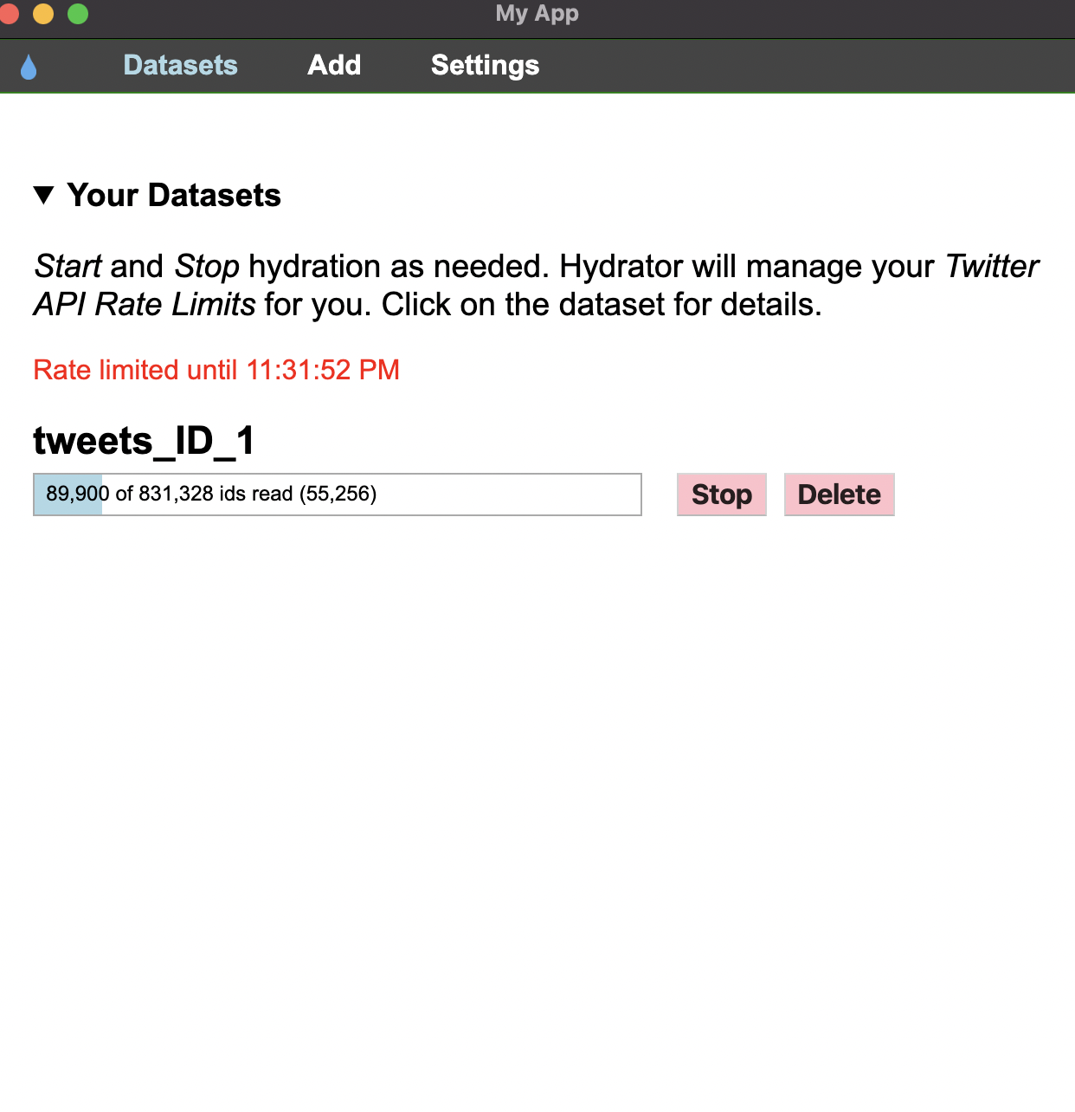
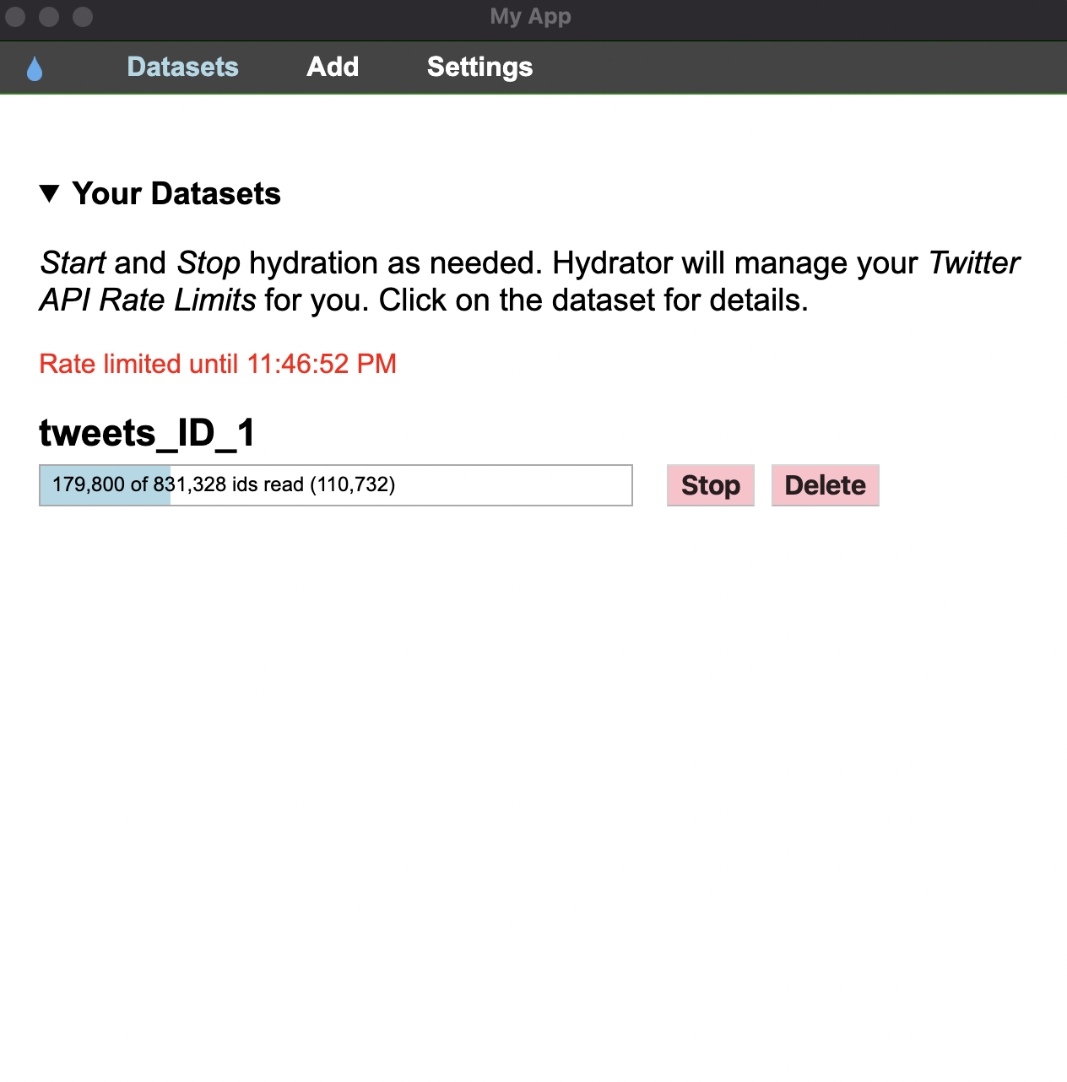
Waiting …
.

Slide 11
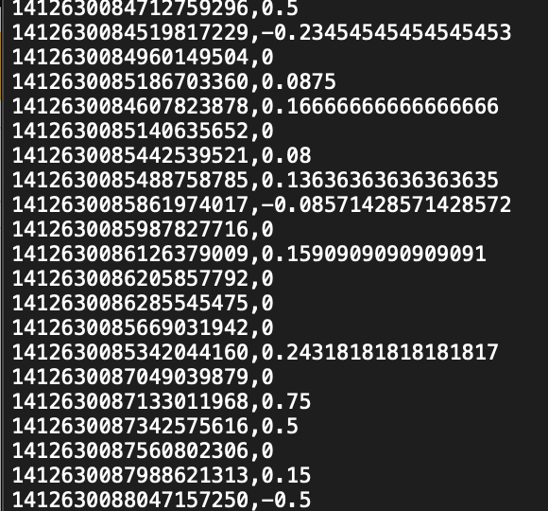
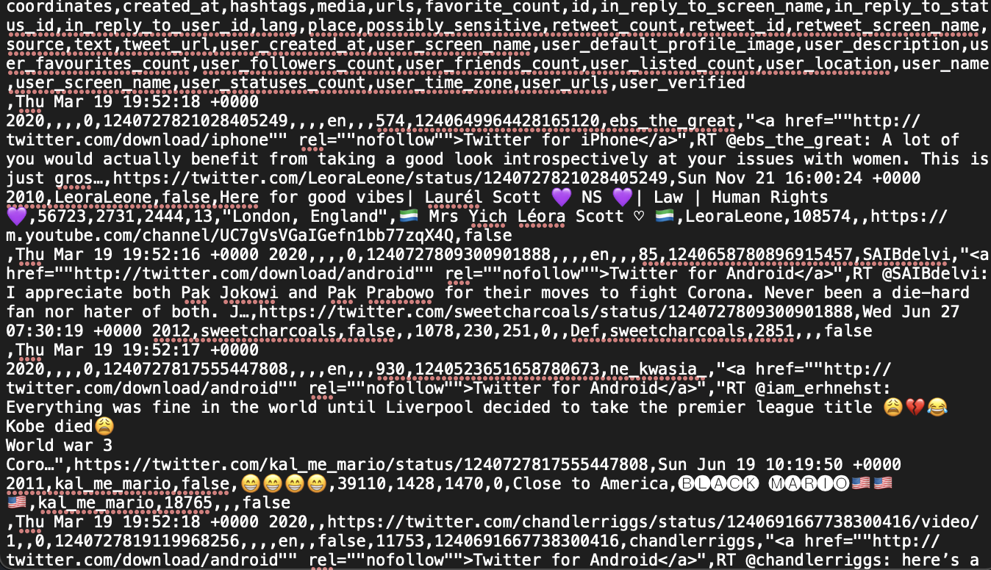
Before After
.
Not useful!

Slide 12
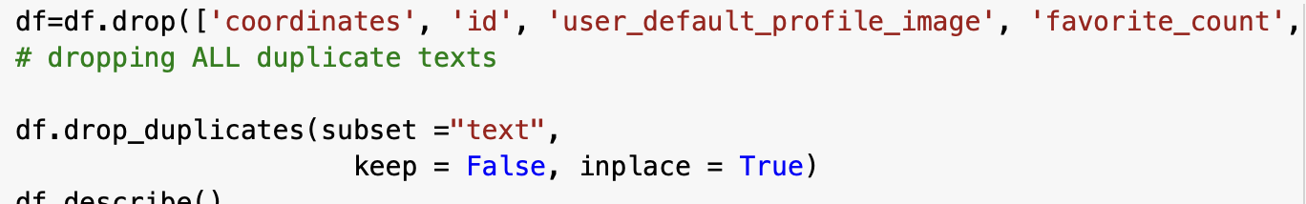
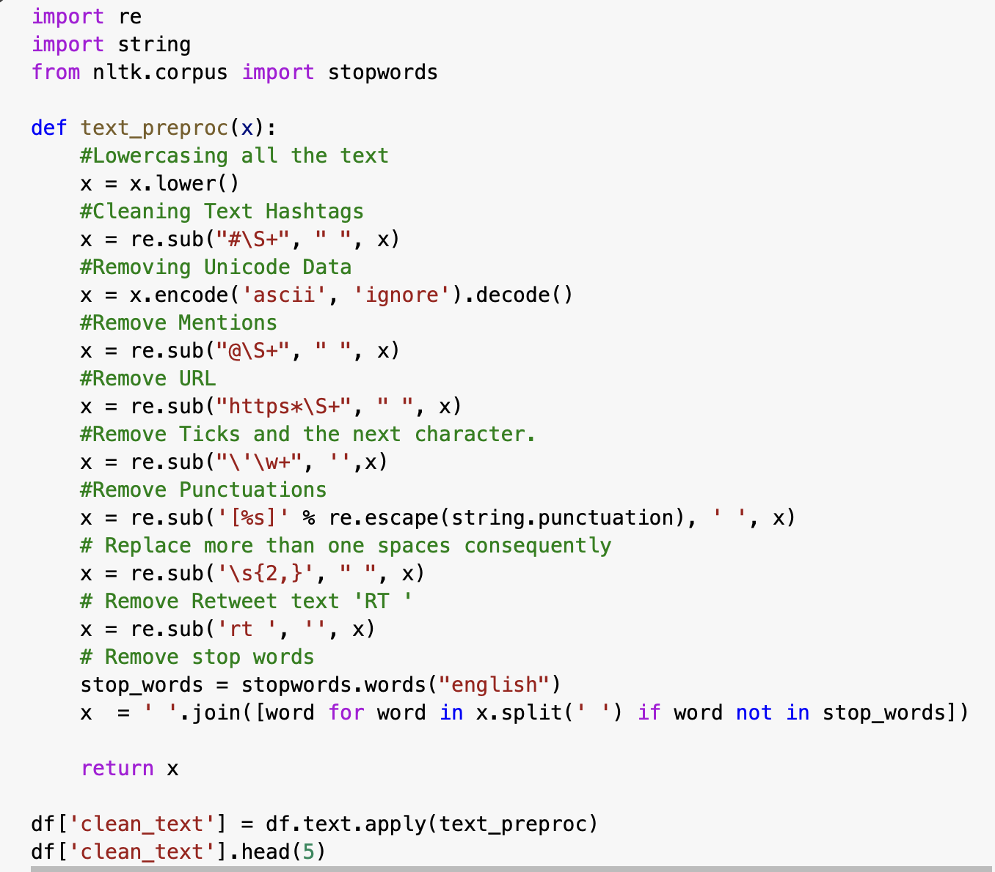
Data Preprocessing
.

Slide 13
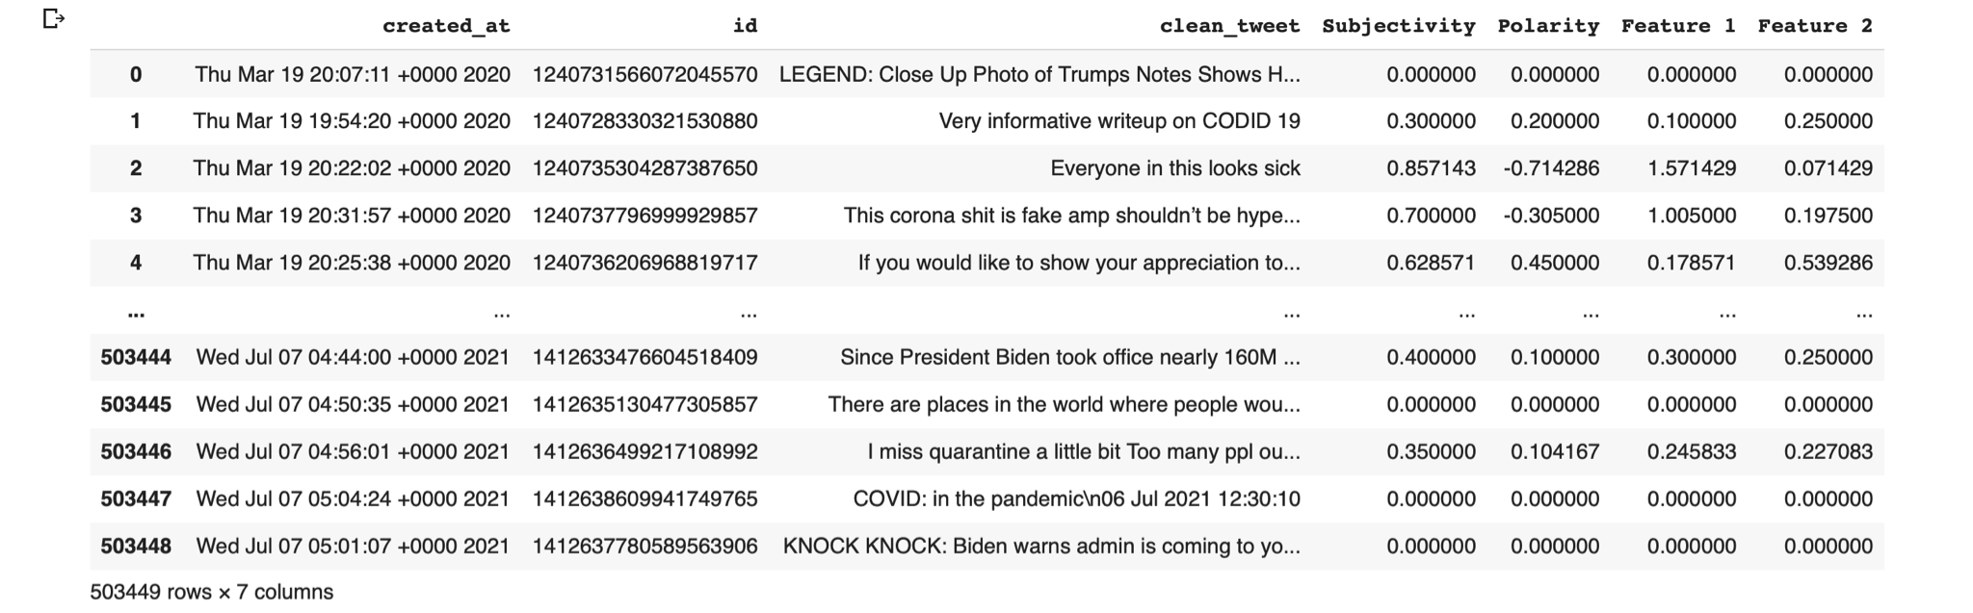
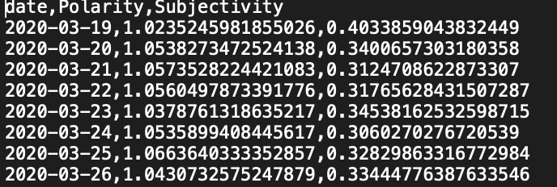
Sentiment Analysis
from textblob import TextBlob

Slide 14
503,448 tweets hydrated & analysed

Slide 15
Stocks Analysis + Model
1

Slide 16
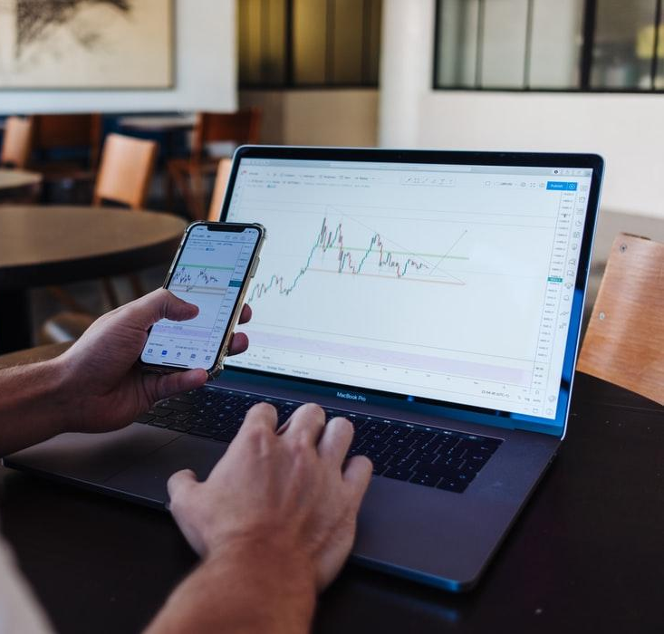
Data Collection
Initial plan: NASDAQ Composite
Plan v2: Wilshire 5000
Final Plan: Top 10 Stocks per Sectors

Slide 17

Data Processing
Creating Indexes based on Sectors by taking 10% of top 10 stocks in that Sector.
Sectors were: Basic Industry, Capital Goods, Consumer Discretionary, Energy, Consumer Services, Finance, Healthcare, Public Utilities, Real Estate, Technology and Transportation

Slide 18
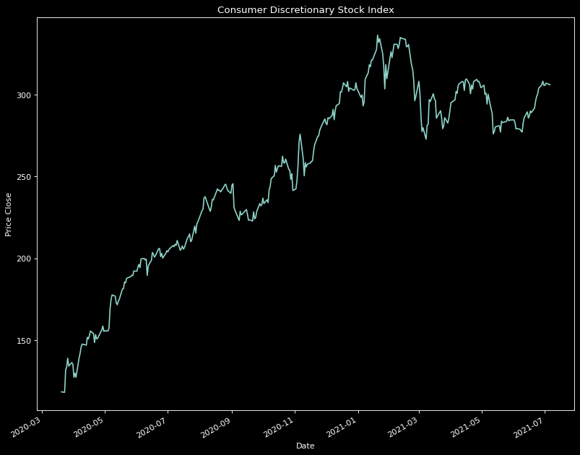
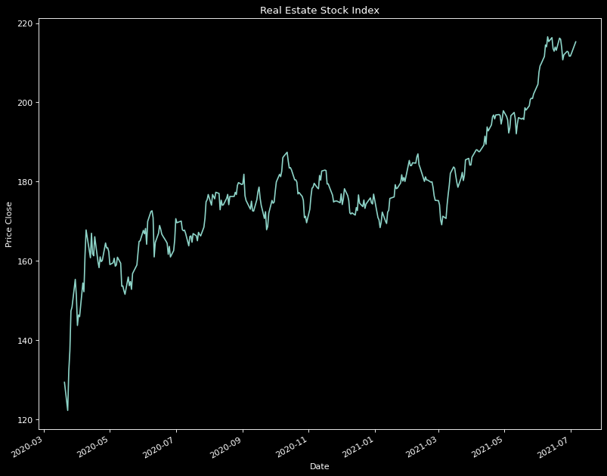
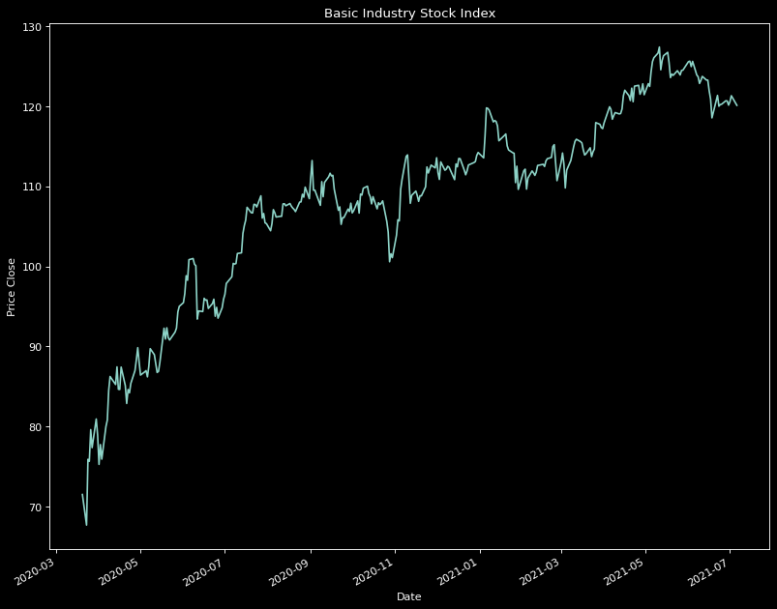
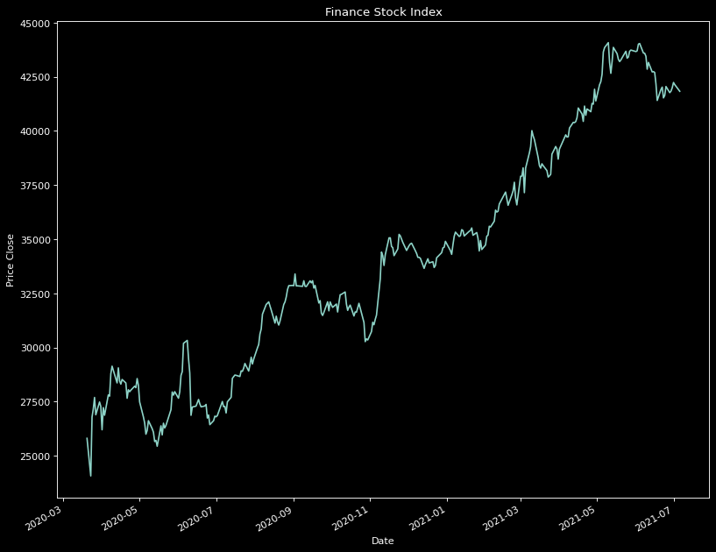
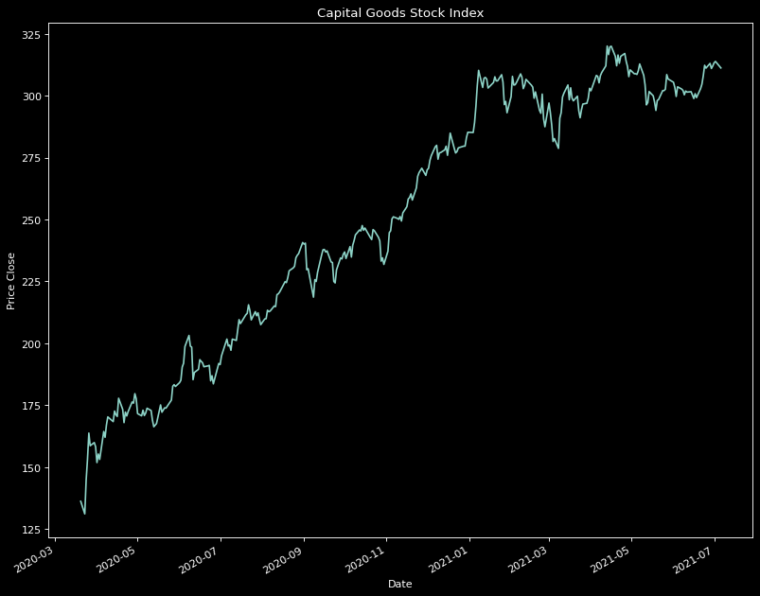
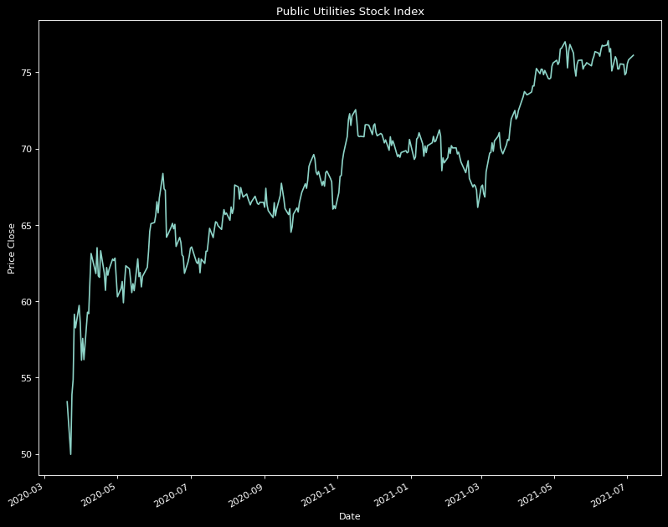
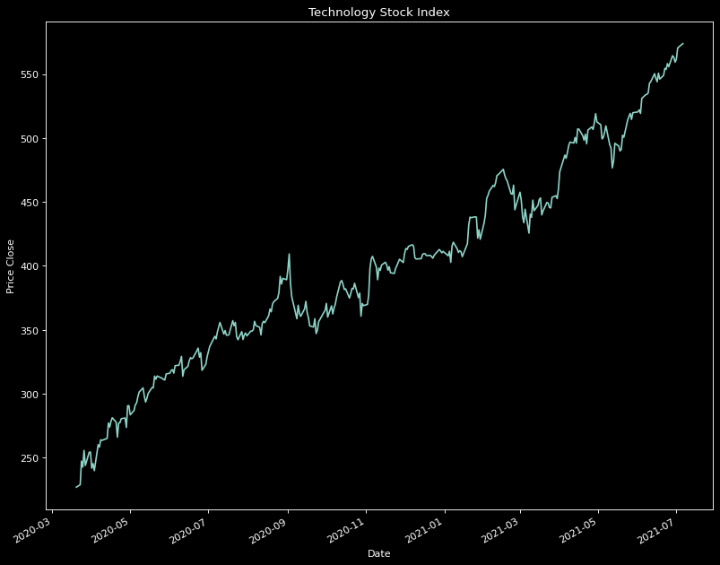
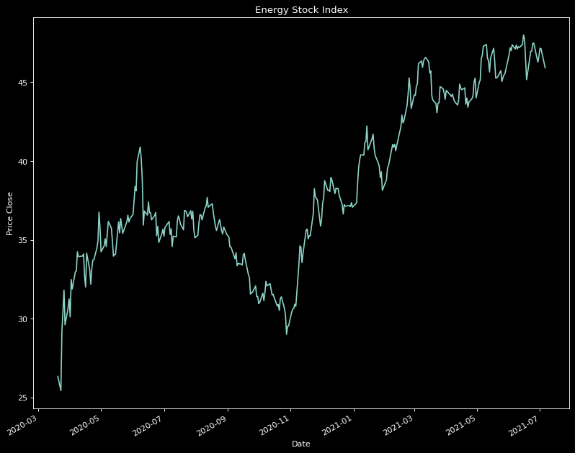
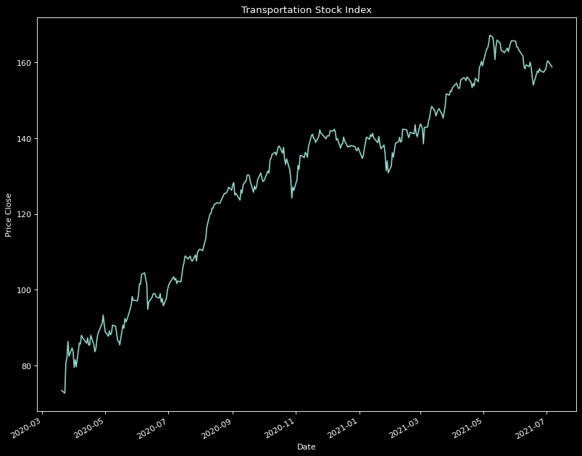
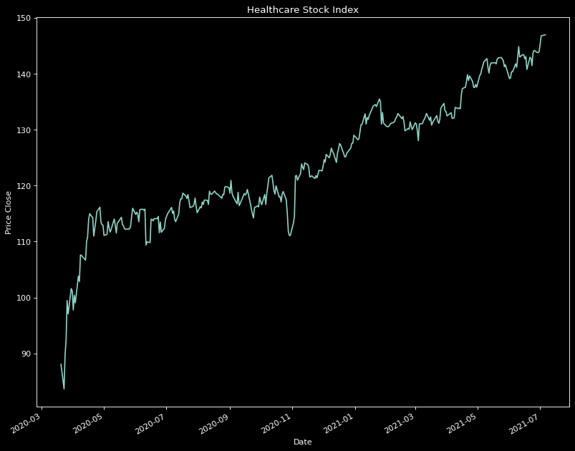
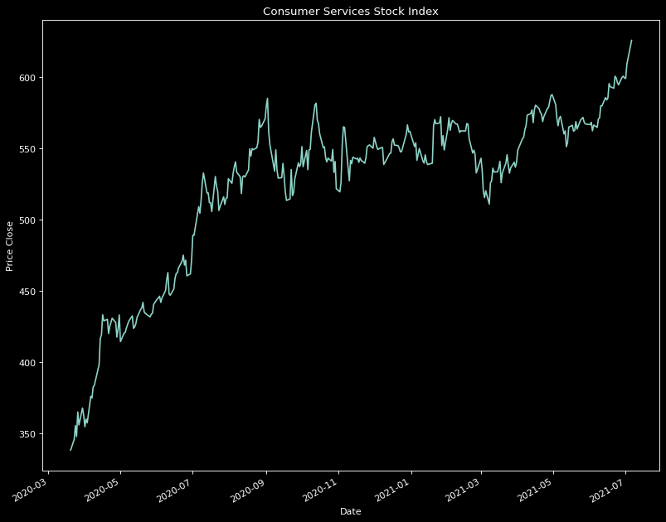
Data
Analysis

Slide 19
Important Charts

Slide 20
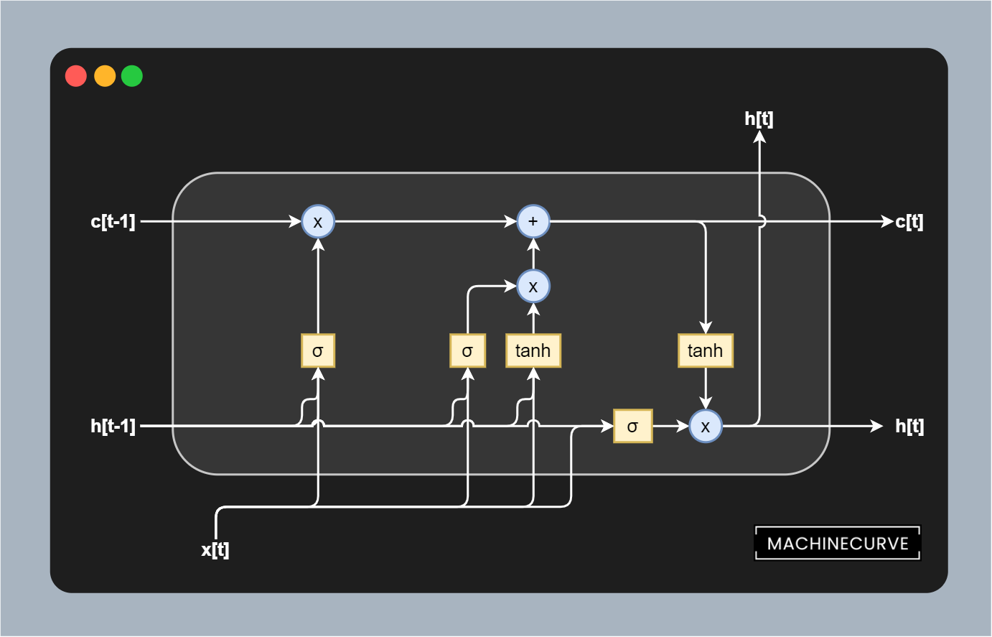
LSTM Model
MinMax Scaling
60 time steps into 1 output
70-30 Test and training set
LSTM with four layers and one output layer
Plotting Predictions and Loss

Slide 21
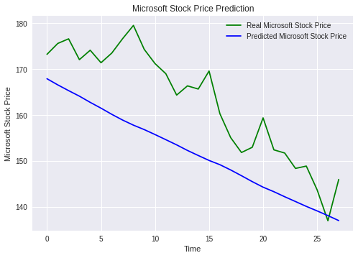
60 Days LSTM Predictions

Slide 22
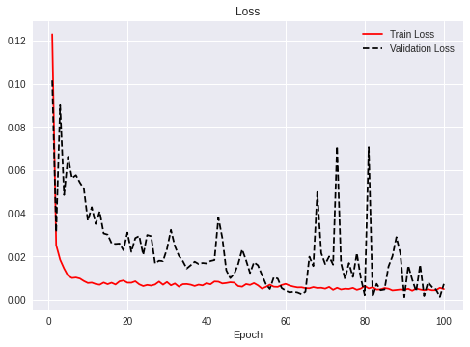
Training Loss vs Validation Loss

Slide 23
Improvements
The team wasn’t operating on a fixed schedule and therefore sometimes people were stuck in deadlocks.
The Covid-19 data we used was very vague and included anything where the word Covid or its stems were used. We could have scraped our own data where the tweets also had parts of Investor speak in it.
We created a all equal 10% index of sectors, and could have experimented with different distributions as well.
The averaging of sentiments was very simple and perhaps there was a better way enforce sentiment strengths.
We could have used more variables like hashtag, or who the tweet was from.

Slide 24
Things we Learned
Twitter ID hydration process - Retrieving raw data
Data Preprocessing - Data cleaning
Sentiment Analysis
Stock Market Trends
LSTM Deep Learning Model

Slide 25
THANKS!
Any questions?
You can find us at:
ggokmen@my.bcit.ca
amishra9@my.bcit.ca

Slide 26
Team Member Contribution
Anadi
Got Stock market data from Yahoo Finance
Created Stock Market Index
Day-Wise Average of Sentiment Analysis
Plotter Graphs
Created LSTM Model
Gokce
Gather data
Discover and access data
Cleanse and validate data
Transform and enrich data
Store Data
Sentiment Analysis

Slide 27
Citation Lists
https://theneuralblog.com/hydrating-tweet-ids/
https://ieee-dataport.org/open-access/coronavirus-covid-19-tweets-dataset#files
https://developer.twitter.com/en/developer-terms/agreement-and-policy
https://github.com/DocNow/twarc
https://github.com/DocNow/hydrator
https://fknol.com/stock/list/
https://github.com/ranaroussi/yfinance

